Slide 1
Lesson 2:
Database System Concepts & Architecture
CSC430/530 – DATABASE MANAGEMENT SYSTEMS

Slide 2
OUTLINE
Data model.
Database schema and state.
Data independence.
DBMS languages, interfaces & system utilities.
Centralized DBMS architecture.
Two-tier & three-tier client/server DBMS architecture.
DBMS classification.

Slide 3
DATA MODEL: DEFINITIONS
Data model is a set of concepts to describe:
structure of a database,
operations for manipulating these structures, and
certain constraints that the database should obey.
Data model structure & constraints:
Database structure is defined by constructs.
Constraints specify restrictions on valid data that must be enforced at all times.
Data model includes set of operations that govern database retrievals and updates.
Basic operations: Insert, Delete, Update.
User-defined operations: compute_student_gpa, update_inventory.

Slide 4
DATA MODELS: CATEGORIES
Categories of data models:
Conceptual data models.
High-level or semantic.
Provide concepts that are close to the way users perceive data.
Entities, attributes, relationships.
Implementation data models.
Hide many details of data storage, but can be implemented on system directly.
User views and computer storage details.
Physical data models:
Low-level or internal.
Describe how data is stored as files on the computer.
Record formats, record orderings, and access paths.

Slide 5
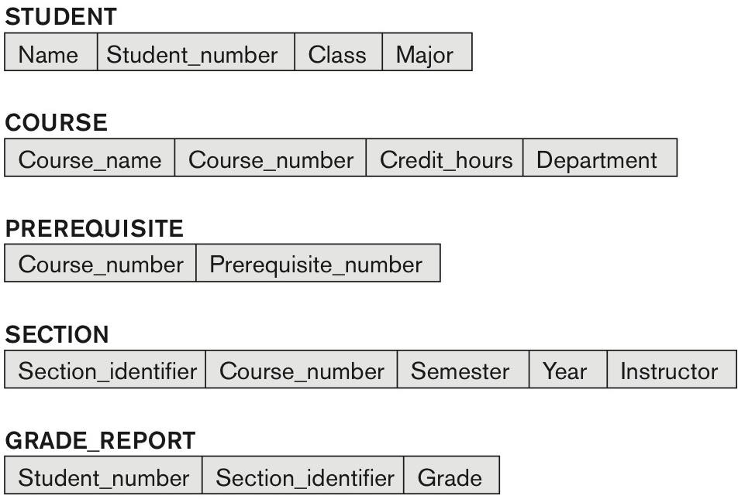
DATABASE SCHEMA & STATE (1)
Data model consists of two parts:
Database schema – description of the database.
Describes database structure and constraints that should hold on the database.
Specified during database design and rarely changed.
Database state – snapshot of the database.
Data in the database at a particular moment in time.
Database state changes every time a value of data item in a
record is changed or a record is inserted or deleted.
Schema Diagram of University Database

Slide 6
DATABASE SCHEMA & STATE (2)
Distinction between database schema & state:
The database schema changes very infrequently (schema evolution).
The database state changes every time the database is updated.
Schema = intension, state = extension.
DBMS ensures valid state of database, based on the database schema (structure & constraints).

Slide 7
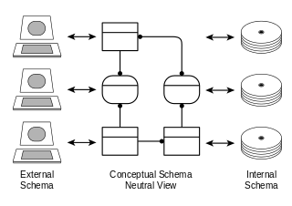
THREE-SCHEMA ARCHITECTURE (1)
Three-schema architecture supports database approach characteristics:
Self-describing nature (DBMS catalog).
Program-data independence.
Support of data multiple views.
Three-Schema Architecture Simplified View

Slide 8
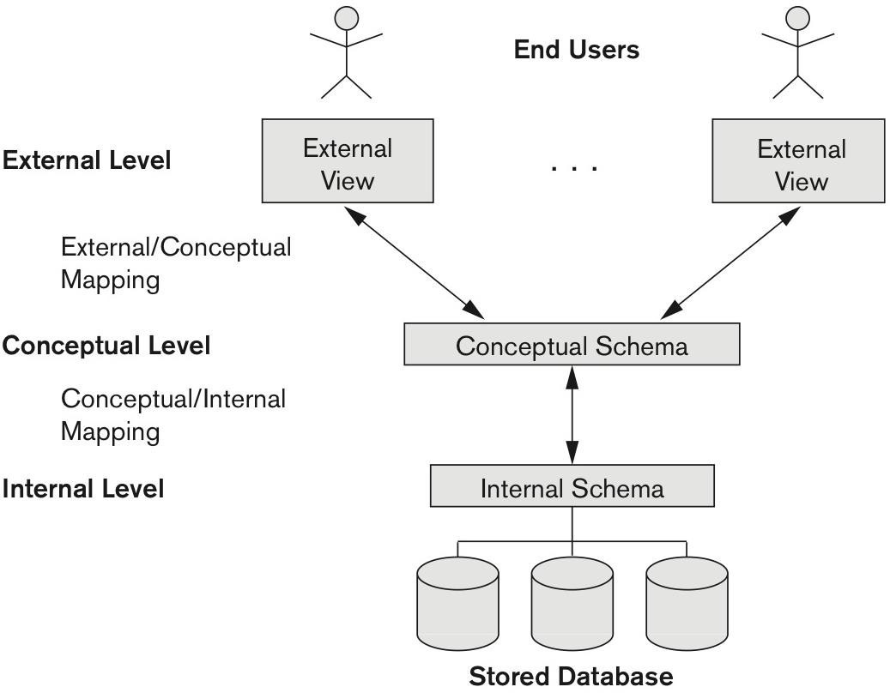
THREE-SCHEMA ARCHITECTURE (2)
Schemas are defined in three levels:
Internal schema.
Describes details of physical data storage & accessing paths.
Uses physical data model.
Conceptual schema.
Describes structure of the whole database to the user.
Uses conceptual or implementation data models.
External schema.
Describes the specific part of the database to a user.
Uses same data models as conceptual schema.
Mappings among schema levels are needed to transform
requests and data.
Three-Schema Architecture Detailed View

Slide 9
DATA INDEPENDENCE
Data independence – capacity to change the schema at one level of the database system
without having to change the schema at the next higher level.
Two types of data independence:
Logical data independence:
Change of conceptual schema ≠ change of external schemas.
Physical data independence:
Change of internal schema ≠ change of conceptual schema.
Change of schema at a lower-level will only causes change
of mapping to higher-level schemas.
Main benefit: no need to change application programs since they refer to the external schemas.
Three-Schema Architecture

Slide 10
DBMS LANGUAGES: DDL
Next step after DBMS design is the implementation of the conceptual and internal schemas
and mappings between two.
Done by data definition language (DDL).
Data definition language (DDL):
Used by the DBA and database designers to specify the conceptual schema of a database.
In addition, DDL is used to define internal and external schemas.

Slide 11
DBMS LANGUAGES: DML
Once the database schemas are compiled and database is populated with data, user must have
means to manipulate the data.
Done by data manipulation language (DML).
Data manipulation language (DML):
Used to specify database retrievals and updates.
High-level (non-procedural).
Specifies which data to retrieve, rather than how to retrieve it.
Operates on a set of data.
Low-level (procedural).
Specifies how to retrieve the data.
Operates on a single record.

Slide 12
DBMS SYSTEM UTILITIES
DBMS utilities offer following functionality:
Loading.
Loading existing data files into DB or transferring data form one DB to another.
Backup.
Create a backup of database current state.
Storage reorganization.
Reorganize database files to improve performance
Performance monitoring.
Monitors database usage to check if reorganization is needed.
Data dictionary system.
Data dictionary stores meta-date, design decisions, usage standards, application program description and user information.
Application development environments.
Aid in database application development.

Slide 13
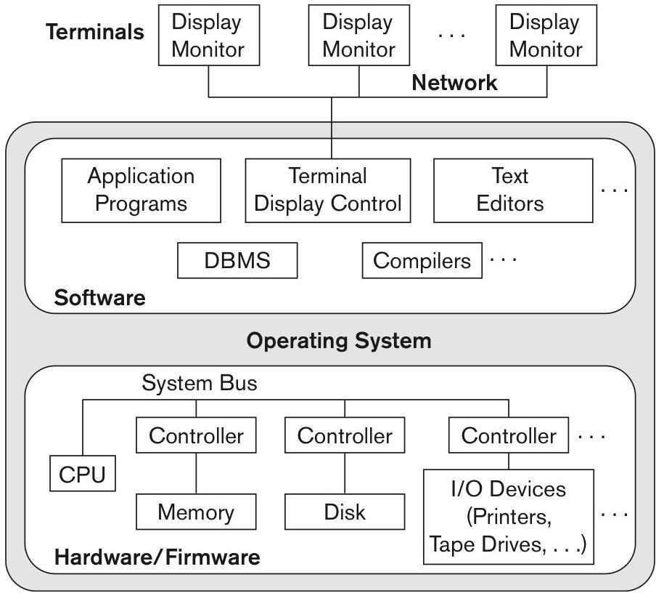
CENTRALIZED DBMS ARCHITECTURE
Centralized DBMS architecture combines all elements into a single system.
DBMS software, hardware, application programs, and user interface processing software.
Centralized Architecture

Slide 14
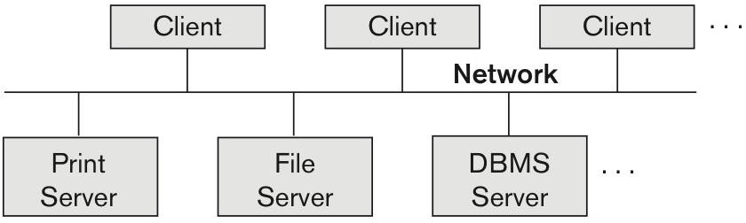
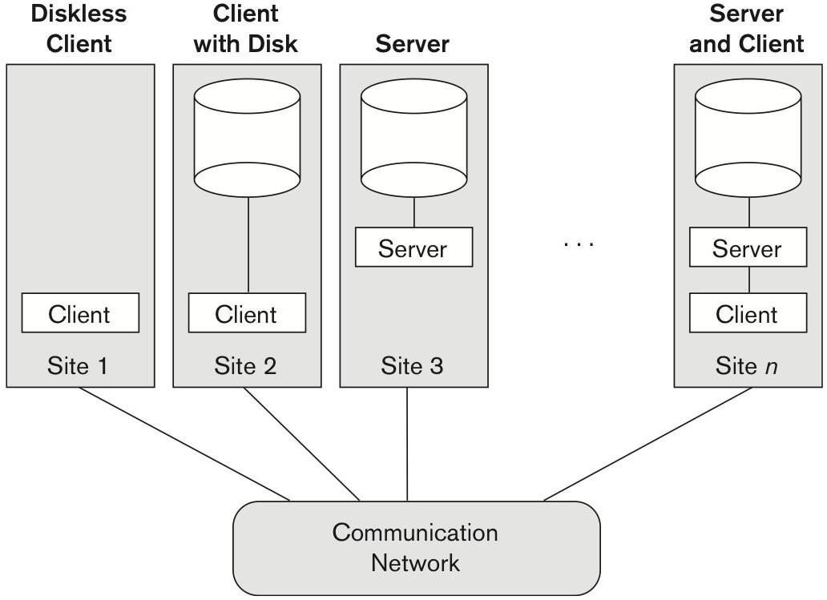
TWO-TIER CLIENT/SERVER ARCHITECTURE (1)
Basic two-tier client/server architecture:
Specialized servers with specialized functions.
Print server.
File server.
DBMS server.
Web server.
Email server.
Clients can access the specialized servers as needed.
When client requires access to additional functionality
(database access) it connects to the server.
Logical Two-Tier Client/Server Architecture
Physical Two-Tier Client/Server Architecture

Slide 15
TWO-TIER CLIENT/SERVER ARCHITECTURE (2)
Two-tier client/server DBMS architecture:
User interface and application programs are stored on the client side.
Query & transaction functionality related to SQL processing is performed by the server (SQL server).
When DBMS access required, program (client) establishes a connection to the DBMS (server).
Once connection is established the client can communicate with the DBMS.
Query results are sent back to client program which processes and displays the results.

Slide 16
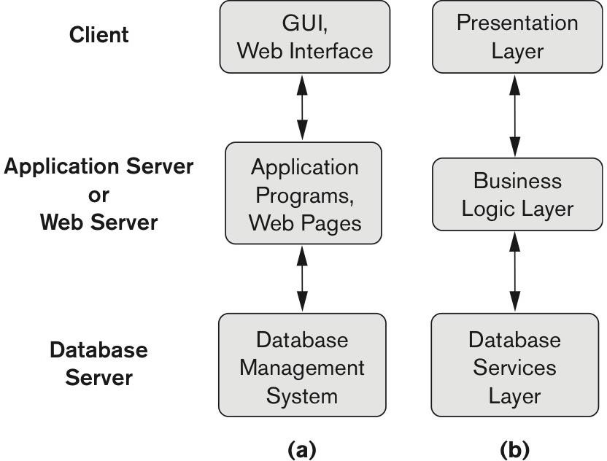
THREE-TIER CLIENT/SERVER ARCHITECTURE
Three-tier is a common architecture for web applications.
Intermediate layer between client and database server.
Clients → user interface & web browsers.
Middle tier → application server or web server.
Runs apps or stores business rules (procedures, constrains) that are used to access the data form server.
In addition, used for security by checking client credentials.
Three-Tier Client/Server Architecture

Slide 17
DBMS CLASSIFICATION
DBMS are classified by following characteristic:
Data model.
Hierarchical.
Network.
Relational.
Object.
Document.
Graph.
Key-value.
Number of users.
Single-user.
Multi-user.
Number of sites.
Centralized (single site).
Distributed (multiple sites).
Homogeneous (same DBMS on all sites).
Heterogeneous (different DBMS on sites).
Cost.
Open source (free).
MySQL, PostgreSQL.
Commercial ($$$).

Slide 18
SUMMARY
Data model definition and categories.
Database schema and state.
Three-schema architecture and mappings.
Logical and physical data independence.
DBMS languages.
Two-tier and three-tier DBMS architecture.
DBMS classification.

